Slide 1
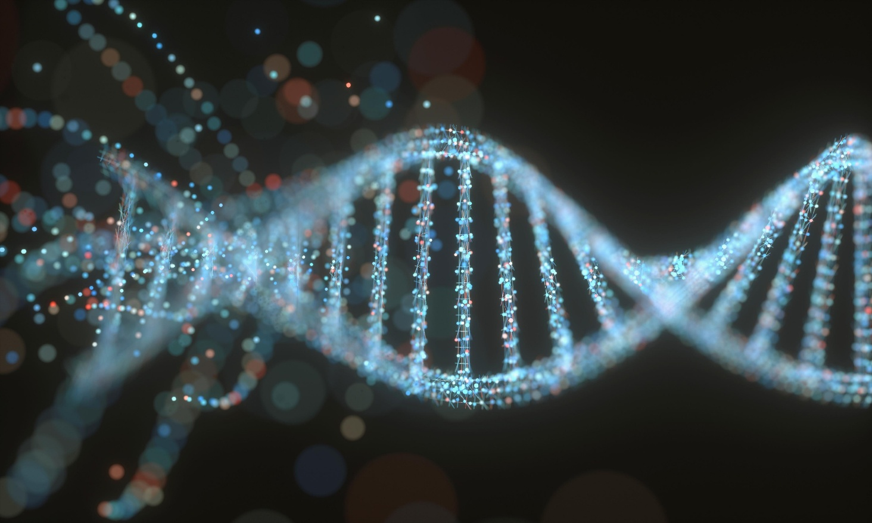

SCI225 · PATHOPHYSIOLOGY
Week Four
Neurological Disorders
Prof. XYZ Nightingale College
// week 4 visual
Notes:
Welcome to Week 4: Neurological Disorders.

Slide 2

TODAY'S SESSION
Agenda
01
Nervous system structure & function
02
Pain & sensory pathways
03
Sleep, circadian, temperature
04
Cerebral hemodynamics & ICP
05
Motor disorders: PD, MS, ALS
06
Stroke & traumatic brain injury
SCI225 · WEEK 4
02 / 38
Notes:
Walk through today's agenda.

Slide 3
WEEK FOUR
Learning objectives
1
Identify the structure and function of the neurologic system.
2
Explain pain, temperature, sleep, and sensory function.
3
Discuss alterations in cognitive systems, cerebral hemodynamics, and motor function.
SCI225 · WEEK 4
03 / 38
Notes:
State Week 4 learning objectives.

Slide 4
Weekly resources
Required & supplemental
Tips for success
Chapter 14 — The Neurologic System (Huether & McCance)
Week 4 Study Guide — covers all objectives
Khan Academy: Nervous System modules
NCLEX-style practice questions in course resources
Focus on pathophysiologic mechanisms — not just facts.
Connect each disorder back to normal anatomy and function.
Use the cranial nerve mnemonic during clinical practice.
SCI225 · WEEK 4
04 / 38
Notes:
Weekly resources and required reading.

Slide 5

04
MODULE FOUR
Week Four
Neurologic structure, sensory and motor function, and the major neurological disorders.
SCI225 · WEEK 4
05 / 38
Notes:
Open Module 4 — Week Four core content.

Slide 6
ACTION ITEMS
What is due this week?
Complete the Week 4 Pre-Assessment.
Read Chapter 14 — The Neurologic System.
Discussion: Cranial Nerve Assessment (due Saturday, May 31).
Attend a Week 4 Webinar.
Complete the Week 4 Case Study (due Saturday, May 31, 11:59 pm MT).
Take the Week 4 Webinar Quiz (due Saturday, May 31, 11:59 pm MT).
SCI225 · WEEK 4
06 / 38
Notes:
Cover what is due this week.

Slide 7
SECTION · STRUCTURE & FUNCTION
Section objective
1
Identify the structure and function of the neurologic system.
SCI225 · WEEK 4
07 / 38
Notes:
Section objectives — neurologic structure and function.

Slide 8
The nervous system: an overview
Discussion prompts:
What are the two main divisions of the nervous system?
What's the role of the autonomic nervous system?
How do CNS and PNS communicate?
// nervous system diagram
Notes:
Open the discussion: nervous system overview.

Slide 9
Neurons vs. glial cells
Neurons
Glial cells (neuroglia)
Types: sensory (afferent), motor (efferent), interneurons
Astrocytes — BBB support, neuronal environment
Structure: dendrites receive, axon transmits, myelin speeds conduction
Oligodendrocytes — CNS myelin formation
Microglia — CNS immune defense, debris clearance
Function: generate/transmit action potentials; communicate via neurotransmitters
Schwann cells — PNS myelin formation and repair
SCI225 · WEEK 4
09 / 38
Notes:
Compare neurons vs. glial cells.

Slide 10
Myelin & saltatory conduction
Action potentials "jump" from one node of Ranvier to the next along myelinated axons — orders of magnitude faster than continuous conduction.
Demyelination (MS, Guillain-Barré) disrupts this pattern → slowed signals, sensory and motor deficits.
// myelin / Ranvier diagram
Notes:
Myelin and saltatory conduction.

Slide 11
Brain structures and functions
Structure
Function
Cerebrum
Higher cognition, voluntary movement, sensation, language
Cerebellum
Coordination, balance, fine-motor control
Brainstem
Vital functions: respiration, heart rate, consciousness pathways
Hypothalamus
Homeostasis — temperature, hunger, hormones, circadian rhythm
Thalamus
Sensory relay station to cortex
Basal ganglia
Movement initiation, motor learning
Limbic system
Emotion, memory, motivation
SCI225 · WEEK 4
11 / 38
Notes:
Major brain structures and their roles.

Slide 12
Ventricular system & CSF
CSF produced by choroid plexus in lateral ventricles.
Flows: lateral → 3rd → 4th → subarachnoid space.
Reabsorbed by arachnoid villi into venous system.
Disruption → hydrocephalus, ↑ ICP.
// ventricular system diagram
Notes:
Ventricular system and CSF.

Slide 13
Lobes of the cerebral cortex
Lobe
Function
Frontal
Voluntary motor, executive function, judgment, Broca's area (speech production)
Parietal
Somatosensory processing, spatial awareness, sensory integration
Temporal
Auditory processing, memory, Wernicke's area (speech comprehension)
Occipital
Visual cortex — processes all visual input
Limbic system
Emotions, memory, motivation — hippocampus & amygdala
SCI225 · WEEK 4
13 / 38
Notes:
Lobes of the cerebral cortex.

Slide 14
Cranial nerves
Mnemonic — "On Old Olympus Towering Top, A Finn And German Viewed Some Hops"
#
Nerve
Function / clinical pearl
I
Olfactory
Smell
II
Optic
Vision
III
Oculomotor
Eye/pupil — damage → fixed dilated pupil (uncal herniation)
IV–VI
Trochlear, Trigeminal, Abducens
Eye movement; face sensation/chewing; lateral eye
VII
Facial
Expression, taste — damage → facial droop (Bell's palsy or stroke)
VIII–X
Vestibulocochlear, Glossopharyngeal, Vagus
Hearing/balance; swallow/gag; parasympathetic, voice
XI–XII
Accessory, Hypoglossal
Shoulder/neck; tongue movement
SCI225 · WEEK 4
14 / 38
Notes:
Cranial nerves — mnemonic and clinical pearls.

Slide 15
KNOWLEDGE CHECK
Question 1 of 4
A patient with a demyelinating disorder develops delayed voluntary movement. Which pathophysiologic change accounts for this finding?
A
Slower impulse conduction from loss of saltatory conduction
B
Slower impulse conduction from less synaptic release
C
Slower impulse conduction from poor membrane exchange
D
Slower impulse conduction from reduced neural blood flow
SCI225 · WEEK 4
15 / 38
Notes:
Knowledge check — demyelination.

Slide 16
SECTION · PAIN & SENSATION
Section objective
2
Explain pain, temperature, sleep, and sensory function.
SCI225 · WEEK 4
16 / 38
Notes:
Section objectives — pain, temperature, sleep, sensory.

Slide 17
Pain pathways
→
→
→
01
02
03
04
Nociceptors
Spinal cord
Thalamus
Perception
Specialized receptors detect tissue damage / noxious stimuli.
Sensory neurons carry signal to dorsal horn.
Ascending tract relays to cortex.
Somatosensory cortex; descending modulation (gate control).
SCI225 · WEEK 4
17 / 38
Notes:
Pain pathways.

Slide 18
PAIN TYPE
Nociceptive pain
Arises from actual or potential tissue damage — somatic or visceral.
Somatic: well-localized, sharp, aching — skin, muscle, bone.
Visceral: poorly localized, cramping, often referred — internal organs.
Referred: cardiac ischemia → left arm/jaw; liver pain → right shoulder.
Treatment: NSAIDs, opioids, acetaminophen — COX pathway and opioid receptors.
SCI225 · WEEK 4
18 / 38
Notes:
Nociceptive pain.

Slide 19
PAIN TYPE
Neuropathic pain
Arises from damage or dysfunction of the nervous system itself — not tissue injury.
Quality: burning, shooting, electric-shock; allodynia and hyperalgesia.
Causes: diabetic neuropathy, postherpetic neuralgia, phantom limb, MS, SCI.
Mechanism: ectopic discharge, central sensitization, loss of inhibitory interneurons.
Treatment: gabapentin, TCAs, SNRIs — often resistant to standard analgesics.
SCI225 · WEEK 4
19 / 38
Notes:
Neuropathic pain.

Slide 20
Sensory pathways and tracts
Tract
Carries
Crosses
Spinothalamic
Pain and temperature
At spinal cord level (contralateral)
Dorsal column / medial lemniscus
Fine touch, vibration, proprioception
At medulla (ipsilateral until then)
Spinocerebellar
Unconscious proprioception
To cerebellum — coordination
Clinical: Brown-Séquard syndrome — ipsilateral motor/proprioception loss + contralateral pain/temp loss below the lesion.
SCI225 · WEEK 4
20 / 38
Notes:
Sensory pathways and tracts.

Slide 21
AROUSAL
Reticular Activating System (RAS)
Function: arousal, wakefulness, attention; relays sensory signals to cortex.
Location: brainstem (pons, midbrain) → projects to thalamus and cortex.
Activity high during wakefulness; decreases during sleep.
Clinical: RAS injury → coma; anesthetics suppress RAS; stimulants activate it.
SCI225 · WEEK 4
21 / 38
Notes:
Reticular Activating System.

Slide 22
Sleep, circadian rhythm & temperature
Sleep & circadian
Temperature regulation
Hypothalamus — suprachiasmatic nucleus drives circadian rhythm
NREM (N1, N2, N3) — N3 is restorative slow-wave sleep
REM — dreaming, memory consolidation
RAS injury disrupts sleep–wake cycles
Hypothalamus = body's thermostat
Fever — pyrogens reset the set point upward
Hypothalamic damage → poikilothermia (cannot regulate temperature)
SCI225 · WEEK 4
22 / 38
Notes:
Sleep, circadian rhythm, and temperature regulation.

Slide 23
KNOWLEDGE CHECK
Question 2 of 4
A patient describes burning, shooting pain that began months after a nerve injury, without any new tissue damage. Which type of pain best describes this presentation?
A
Nociceptive pain from activated pain receptors
B
Neuropathic pain from abnormal nerve signaling
C
Referred pain felt at a distance from the source
D
Acute inflammatory pain from recent tissue injury
SCI225 · WEEK 4
23 / 38
Notes:
Knowledge check — neuropathic pain.

Slide 24
KNOWLEDGE CHECK
Question 3 of 4
A patient becomes difficult to arouse after brainstem injury. Which system is most likely affected?
A
Reticular Activating System (RAS)
B
Limbic System
C
Basal Ganglia
D
Cerebellum
SCI225 · WEEK 4
24 / 38
Notes:
Knowledge check — RAS injury.

Slide 25
SECTION · COGNITION, HEMODYNAMICS & MOTOR
Section objective
3
Discuss alterations in cognitive systems, cerebral hemodynamics, and motor function.
SCI225 · WEEK 4
25 / 38
Notes:
Section objectives — cognition, hemodynamics, motor function.

Slide 26
Alterations in consciousness
Discussion prompts:
What is the Glasgow Coma Scale and how is it used?
How does increased intracranial pressure alter consciousness?
What causes altered levels of consciousness?
// GCS reference
Notes:
Discussion: alterations in consciousness.

Slide 27
HEMODYNAMICS
Cerebral hemodynamics
CBF: normal 50–60 mL/100g/min; ischemia < 20; coma < 10.
Autoregulation: constant CBF across MAP 50–150 mmHg; lost in severe injury.
CPP = MAP − ICP; target > 60 mmHg.
CO₂: hypercapnia → vasodilation, ↑ CBF; hyperventilation temporarily ↓ ICP.
Brain uses ~20% of body O₂; CMRO₂ couples to CBF; fever ↑ demand.
SCI225 · WEEK 4
27 / 38
Notes:
Cerebral hemodynamics.

Slide 28
EMERGENCY
Increased intracranial pressure
Normal ICP: 5–15 mmHg. Causes: hematoma, edema, hydrocephalus, tumor.
Monro–Kellie doctrine: Brain + blood + CSF = constant volume; ↑ in one must ↓ another.
Early signs: headache, vomiting, papilledema, altered consciousness.
Cushing's triad (late): bradycardia + hypertension + irregular respirations → impending herniation.
Management: osmotic therapy, HOB 30°, hyperventilation; monitor CPP.
SCI225 · WEEK 4
28 / 38
Notes:
Increased intracranial pressure.

Slide 29
Herniation syndromes
Type
Mechanism
Hallmark
Uncal
Temporal lobe over tentorium; compresses CN III
Fixed dilated ipsilateral pupil
Central
Downward displacement of brainstem
Cushing's triad, ↓ consciousness
Tonsillar
Cerebellar tonsils through foramen magnum
Medullary compression → respiratory arrest
Key finding: unilateral fixed and dilated pupil is a neurosurgical emergency.
SCI225 · WEEK 4
29 / 38
Notes:
Herniation syndromes.

Slide 30
Motor function — UMN vs. LMN
Upper motor neuron lesion
Lower motor neuron lesion
Spasticity
Hyperreflexia
Babinski sign
No significant atrophy
Flaccid paralysis
Muscle atrophy
Hyporeflexia
Fasciculations
SCI: initial flaccid → progresses to spastic below lesion level.
SCI225 · WEEK 4
30 / 38
Notes:
Motor function — UMN vs LMN.

Slide 31
MOVEMENT DISORDER
Parkinson's disease
Pathophysiology: loss of dopaminergic neurons in substantia nigra → disrupted motor control; acetylcholine becomes dominant.
Cardinal signs (TRAP): Tremor (resting), Rigidity (cogwheel), Akinesia/bradykinesia, Postural instability.
Treatment: Levodopa/carbidopa (gold standard); MAO-B inhibitors, dopamine agonists, anticholinergics; DBS for refractory cases.
SCI225 · WEEK 4
31 / 38
Notes:
Parkinson's disease.

Slide 32
DEMYELINATING
Multiple sclerosis
Pathophysiology: autoimmune destruction of CNS myelin; oligodendrocytes damaged; demyelinated plaques.
Pattern: relapsing-remitting most common — episodes of deficit followed by partial/full recovery; over time → progressive disability.
Symptoms: optic neuritis, limb weakness, numbness, ataxia, fatigue, bladder dysfunction, cognitive change.
Distinction: CNS only — Guillain-Barré is the peripheral counterpart.
SCI225 · WEEK 4
32 / 38
Notes:
Multiple sclerosis.

Slide 33
MOTOR NEURON DISEASE
Amyotrophic lateral sclerosis (ALS)
Progressive degeneration of both upper and lower motor neurons — cortex, brainstem, spinal cord.
Hallmark: progressive muscle weakness and wasting with preserved sensation.
Course: fasciculations, atrophy, dysphagia, dysarthria → respiratory failure.
Prognosis: no cure; median survival 3–5 yrs. Riluzole (glutamate blocker) modestly slows progression.
SCI225 · WEEK 4
33 / 38
Notes:
Amyotrophic lateral sclerosis (ALS).

Slide 34
Stroke pathophysiology
Ischemic (87%)
Hemorrhagic
↓ CBF → O₂ and glucose deprivation → neuron death
Vessel rupture → blood in parenchyma or subarachnoid space
Causes: hypertension, aneurysm rupture, AVM
Causes: thrombosis, embolism, systemic hypoperfusion
Penumbra — ischemic but salvageable tissue (target of tPA)
FAST — Face drooping · Arm weakness · Speech difficulty · Time to call 911.
SCI225 · WEEK 4
34 / 38
Notes:
Stroke pathophysiology.

Slide 35
Traumatic brain injury
Injury
Mechanism
Clinical pearl
Primary
Direct mechanical damage at impact
Contusion, laceration, diffuse axonal injury
Secondary
Hours to days after impact
Edema, ischemia, excitotoxicity, herniation
Epidural hematoma
Arterial — middle meningeal artery
Lucid interval → rapid deterioration
Subdural hematoma
Venous bridging-vein tear
Elderly, alcohol use, anticoagulation
Concussion
Temporary neurologic dysfunction
No structural damage; resolves with rest
SCI225 · WEEK 4
35 / 38
Notes:
Traumatic brain injury.

Slide 36
BEDSIDE
Neurological assessment
Mental status: LOC, orientation (person, place, time), GCS.
Cranial nerves: 12 pairs; key — CN II vision, III pupils, VII facial, IX/X swallow/gag.
Motor: strength 0–5, UMN vs. LMN signs, drift test.
Sensory: light touch, pain/temp (spinothalamic), proprioception (posterior column).
Reflexes: DTRs 0–4+; Babinski indicates UMN lesion.
SCI225 · WEEK 4
36 / 38
Notes:
Neurological assessment.

Slide 37
KNOWLEDGE CHECK
Question 4 of 4
A patient with Parkinson's disease has slowed movement initiation and reduced voluntary motor control. Which pathophysiologic change accounts for these findings?
A
Loss of dopamine disrupts signaling in motor pathways
B
Loss of myelin slows signaling in motor pathways
C
Loss of neurons reduces signaling in motor pathways
D
Loss of coordination disrupts signaling in motor pathways
SCI225 · WEEK 4
37 / 38
Notes:
Knowledge check — Parkinson's.

Slide 38
KNOWLEDGE CHECK
Question 5 of 5
A patient with a head injury develops bradycardia, widened pulse pressure, and irregular respirations. What do these findings strongly indicate?
A
Progression to increased ICP with brainstem involvement
B
Progression to reduced blood flow with cortical involvement
C
Progression to diffuse swelling with hemispheric involvement
D
Progression to excess fluid with ventricular enlargement
SCI225 · WEEK 4
38 / 38
Notes:
Knowledge check — Cushing's triad.

